Slide 1
K.S. INSTITUTE OF TECHNOLOGY | Dept. of Computer Science & Engineering
VIII SEMESTER INTERNSHIP (BCS803) | REVIEW 1 | 2025-26
INTERNSHIP PROGRESS
Presentation
Review 1
Name:
SRISHTI SOSALE
2025-26
USN:
1KS22CS154
Batch:
2025_CSE_49
Internal Guide:
Dr. Krishna Gudi

Slide 2






01 | Internship Overview
Slide 2 of 8
Organisation / Company
Your Role / Designation
SuprMentr Technologies Pvt Ltd
Full Stack Web Development (MERN) Intern
Type of Internship
Duration
Industry Internship
02 Feb 2026 to 16 May 2026 | 15 Weeks
Tech / Tools Used
External Guide / Supervisor
HTML, CSS, JavaScript, React, Node.js, Express.js, MongoDB, GitHub
Yashas MH, Program Manager, SuprMentr Technologies Pvt Ltd

Slide 3

02 | Work Done So Far
Slide 3 of 8
📝 Tasks / Activities Completed
⚙️ Technologies / Skills
1. Built a Mood Tracker app where users select their mood and the UI updates dynamically using state management. – HTML, CSS, JS, React.
HTML, CSS, JavaScript - Frontend
Basics of React – Frontend framework
2. Developed a Smart Signup Form with real-time validation, error handling, and password visibility toggle. – HTML, CSS, JS (DOM Manipulation), React.
Basics of Node.js, Express.js - Backend
Basics of MongoDB - Database
GitHub
3. Created an Advanced Task Manager with add, delete, and state-based task handling using React hooks. – HTML, CSS, JS, React.
⏱ Time & Effort
4. Built a Weather Application that retrieves and displays real-time weather data using API integration with a clean and responsive user interface. – HTML, CSS, JS, React.
48 hrs/week
Total weeks completed: 10 Weeks

Slide 4
03 | Deliverables & Outcomes
Slide 4 of 8
01
Primary Deliverable
02
Secondary Deliverable
Developed multiple web applications using React, including Mood Tracker, Smart Signup, and Task Manager.
Built a Weather Application using reusable components and API integration to display real-time weather data with a clean and responsive UI.
03
Other Output / Artifact
04
Impact / Value Added
Worked on frontend projects using modern tools like Vite, and learned version control using Git and GitHub for project management and collaboration.
Gained practical experience in frontend development, including building responsive user interfaces, integrating APIs, and managing application structure. Improved problem-solving skills and learned version control using Git and GitHub.

Slide 5
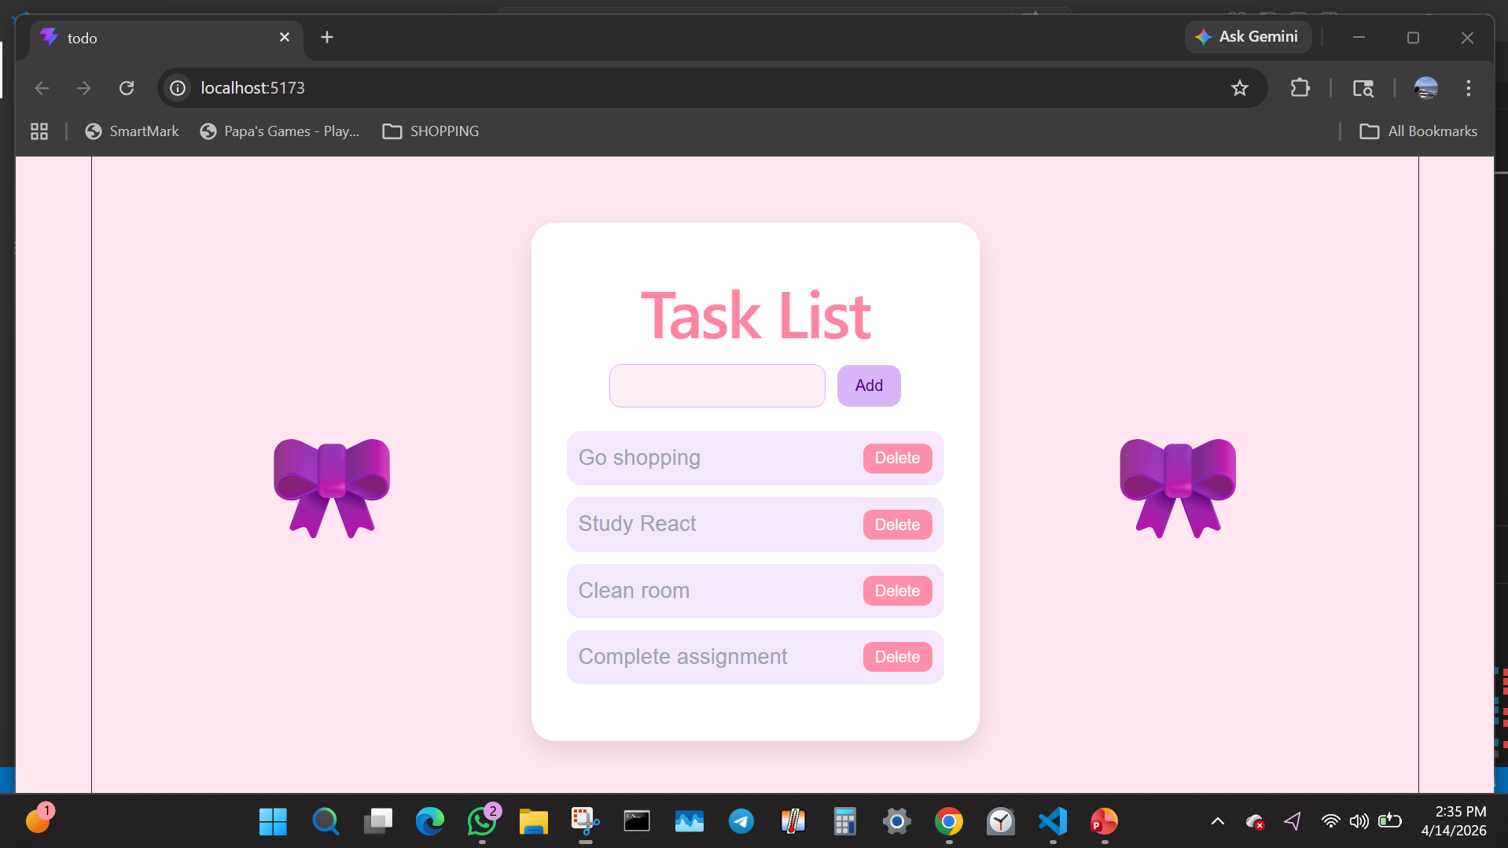
03 | Deliverables & Outcomes
Slide 5 of 8
04

Slide 6
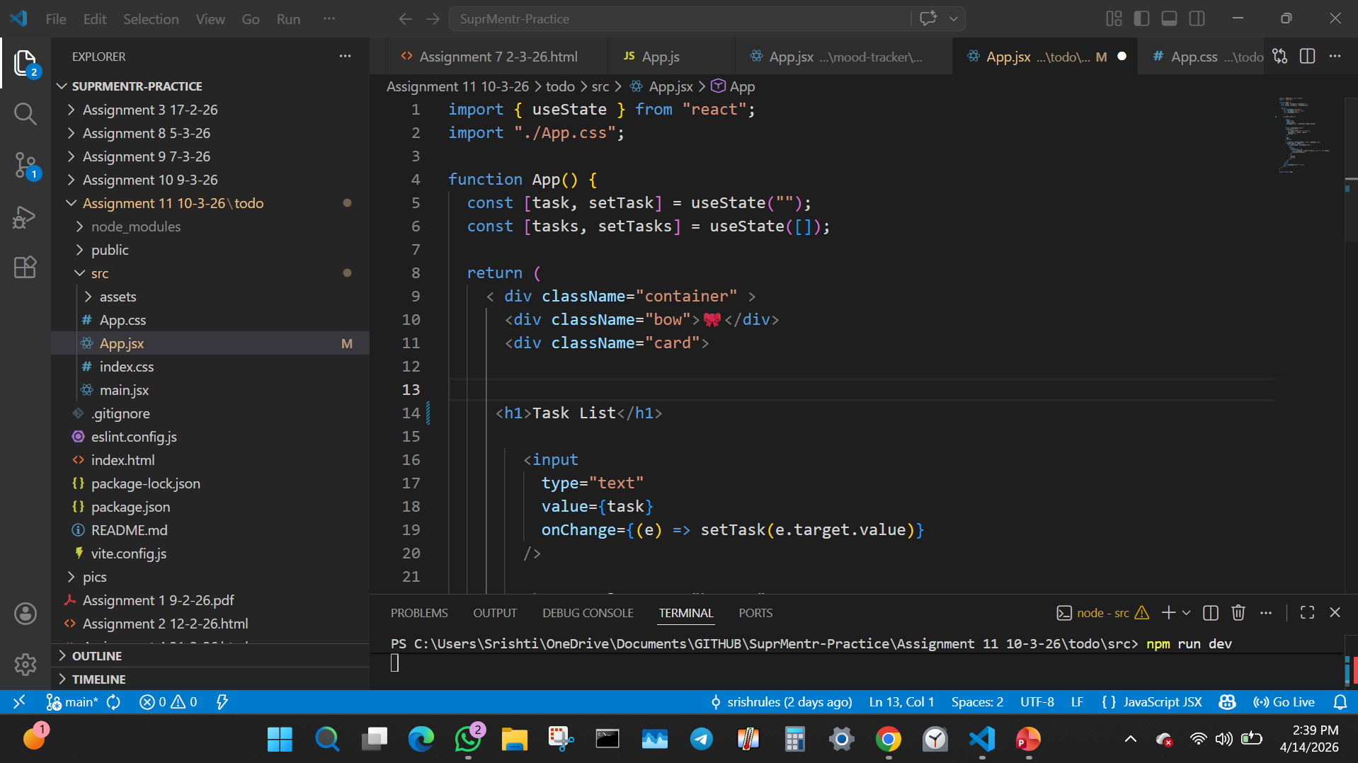
03 | Deliverables & Outcomes
Slide 6 of 8
04

Slide 7


04 | Learnings & Challenges
Slide 7 of 8
Key Learnings
⚡ Challenges & How You Overcame Them
Gained hands-on experience in React development by building interactive applications with state management and dynamic UI updates.
Challenge:
Faced difficulty in understanding React state management and component re-rendering.
How I solved it:
Practiced with projects like Mood Tracker and Task Manager to understand state flow and UI updates.
Learned form handling and validation techniques including real-time input handling and error management.
Challenge:
Struggled with form validation and handling multiple inputs efficiently.
Developed understanding of component-based architecture by creating reusable components and structured project layouts.
How I solved it:
Implemented controlled components and validation logic step-by-step in the Smart Signup project.
Improved frontend design skills using CSS and responsive layouts to build clean and user-friendly interfaces.
Challenge:
Managing dynamic task updates and maintaining consistent UI behavior while adding and deleting tasks.
How I solved it:
Used React state management and hooks to efficiently update and render tasks in real time.

Slide 8

05 | Plan Ahead & Summary
Quick
Summary
📅 Plan for Next Phase (Before Review 2)
Learn how to connect React frontend with a basic Node.js and Express backend
10
Weeks Completed
Practice API integration by working with simple REST APIs and fetching data in frontend applications
10
Tasks Done
Understand database concepts (MongoDB) and how to store and manage application data
3
Deliverables
Build foundational backend skills including routing and basic middleware in Express
5
Key Skills Learnt
Srishti Sosale– 1KS22CS154
Thank you for your time. Open to your feedback and questions!

